Slide 1

6IAS Workshop on 3D Modelling
Welcome
Angela Alfonso Rodrigues (Monash)
Lachlan Grose (Monash)
Leo Portes (UWA)
Mark Jessell (UWA)
Mark Lindsay (CSIRO)
Michel Nzikou (UWA)
Vitaliy Ogarko (UWA)
Guillaume Pirot (UWA)
Louie Zhang (CSIRO)
Mark Jessell
24 – 26th May 2021
Notes:
The University of Western Australia acknowledges that it is situated on Noongar land, that the Noongar people remain the spiritual and cultural custodians of their land and continue to practise their values, languages, beliefs and knowledge.
Welcome……
Program for today…..

Slide 2
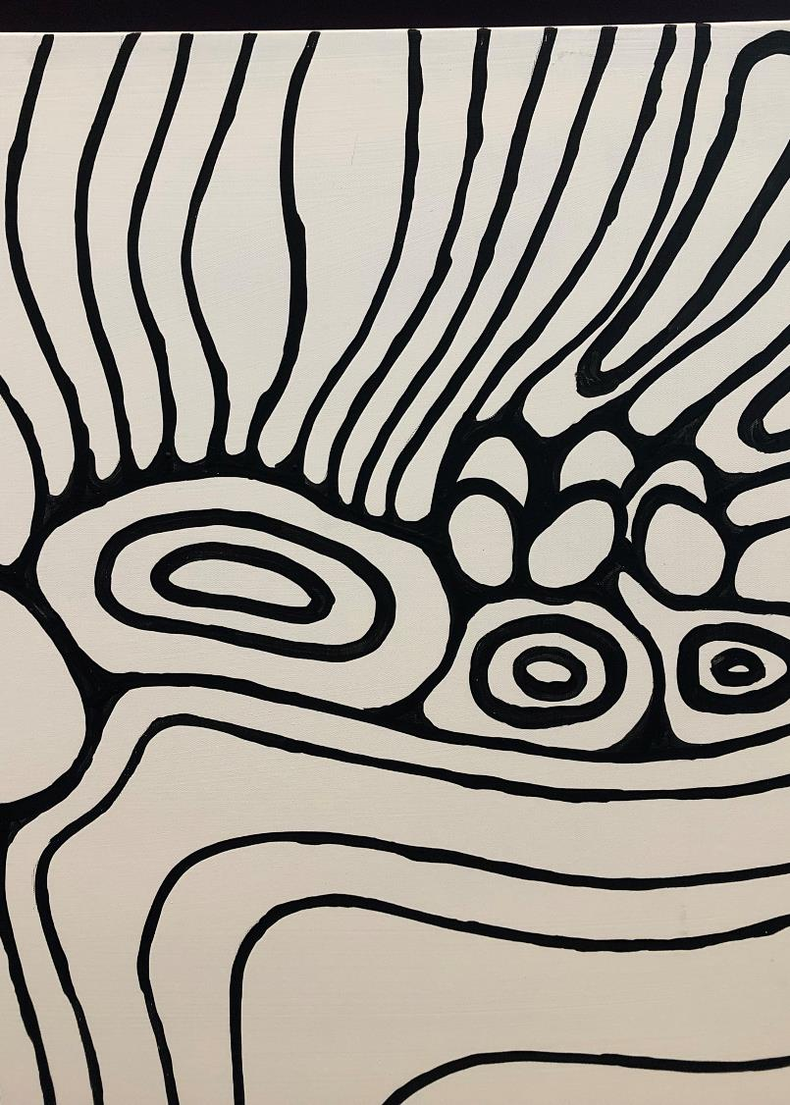
The University of Western Australia acknowledges the traditional owners and custodians of this land, the Wadjuk people of Nyungar nation and pay our respects to Elders both past and present for they hold the knowledge, the language, the traditions and culture of their people and their land

Slide 3
Day 1 Sat 22nd July
Part 1: Principles of 3D geological modelling
9:00 – 9:30 |  | Registration and coffee
9:30 – 10:00 | Mark Jessell (UWA) | Intro & History of 3D modelling
10:00 – 10:20 | Mark Jessell | Different 3D model Use Cases- Outcrop Models, Geophysical Inversions, 3D geological models (Petroleum, Minerals, Hydro)
10:20 – 10:40 | Break
10:40 – 11:00 | Mark Lindsay (CSIRO) | Visualisation and interaction methods for 3D phenomena
11:00 – 11:20 | Mark Jessell | What data and conceptual constraints to use.
11:20 – 12:00 | Mark Jessell/ Mark Lindsay | Introduction to the Loop3D project
12:00 – 12:30 | All | Discussion – troubleshooting, demo setup and suggestions for case studies
12:30 – 2:00 | Lunch
Part 2: Knowledge and models from maps – hands-on
2:00 - 2:45 | Lachlan Grose (Monash) | 3D Interpolation Schemes: Explicit vs Implicit Modelling and other approaches
2:45 – 3:00 | All | Setup / break
3:00 – 4:30 | Mark Jessell | Extracting knowledge from maps with demo
4:30 – 4:45 | Mark Lindsay | Alternate uses for map2loop/model outputs (Fe ore example)
4:45 – 5:00 | All | Summary and discussion
Agenda

Slide 4
Day 2 Sun 23rd July
Part 3: Advanced 3D modelling Methods
9:00 – 9:30 | Angela Alfonso Rodrigues (Monash) | Kalgoorlie case study
9:30 – 10:15 | Mark Jessell / Leo Portes (UWA) | Exploring 3D geological possibility with the Noddyverse
10:15 – 11:00 | Michel Nzikou (UWA) | QGIS Plugins
11:00 – 11:30 | Break
11:30 – 12:00 | Vitaliy Ogarko (UWA) | 3D geophysics using Tomofast-x
12:00 – 12:30 | Louie Zhang (CSIRO) | Spatial random forests
12:30 – 2:00 | All | Summary and discussion
12:30 – 2:00 | Lunch
Part 4: Day Two demonstrations and discussion
2:00 – 3:00 | Mark Lindsay | Manual noddy and 3D geophysical interpretation support
3:00 – 4:00 | Leo Portes | Noddyverse demonstration
4:00 – 5:00 | Guillaume Pirot (UWA) | Loop ‘Flow’
5:00 + | All | Summary and discussion
Agenda

Slide 5

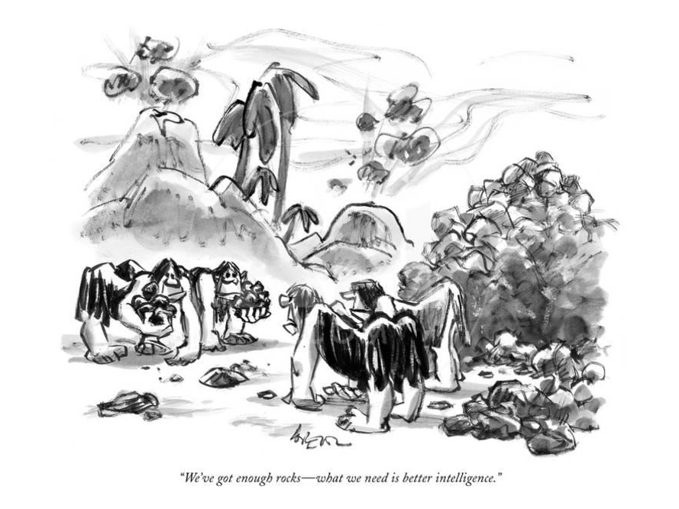
History of 3D geological modelling
Mark Jessell
mark.jessell@uwa.edu.au
24 – 26th May 2021
Lee Lorenz, New Yorker Magazine
Notes:
The University of Western Australia acknowledges that it is situated on Noongar land, that the Noongar people remain the spiritual and cultural custodians of their land and continue to practise their values, languages, beliefs and knowledge.
Welcome……
Excuse our Director Steve who is unfortunately ill and cannot be here….
Program for today…..
Step a back a bit and tell you what we are all about……

Slide 6
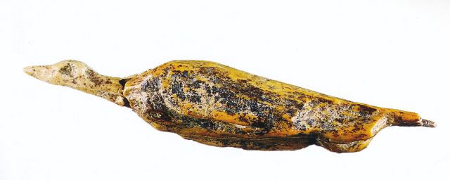
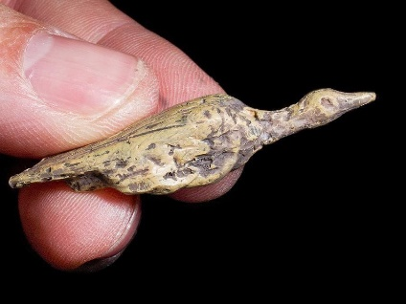
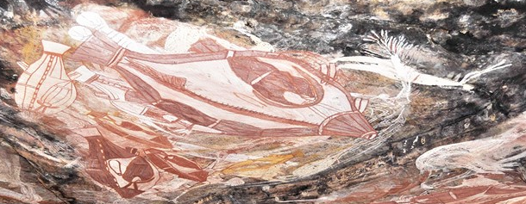
30,000 BCE Early 2D & 3D Models
Water bird from the Hohle Fels Cave in southwestern Germany
Fish from Nawarla Gabarnmang, Northern Territory
Photo: Jean-Jacques Delannoy

Slide 7
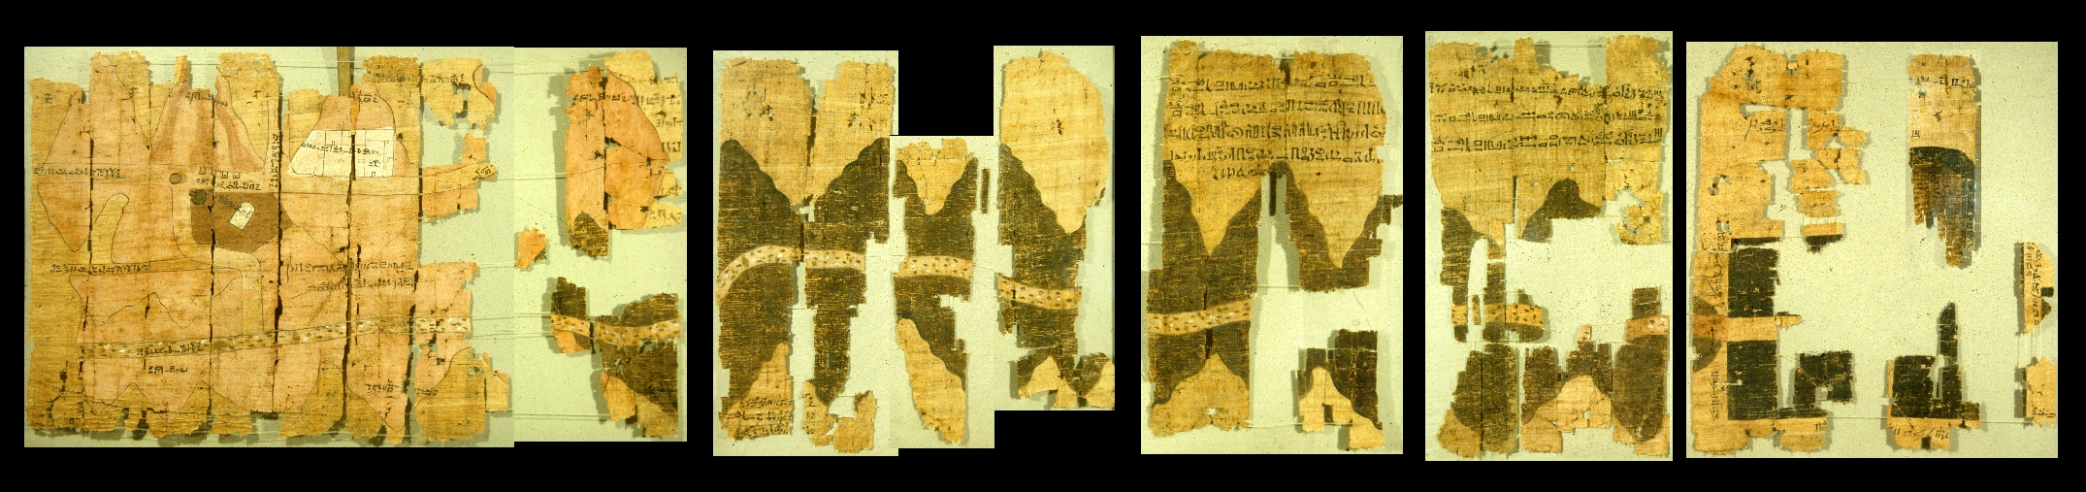
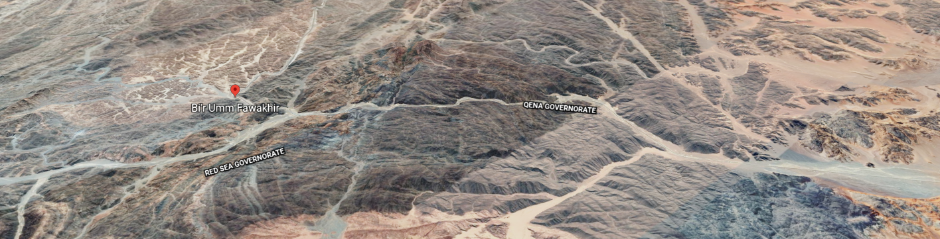
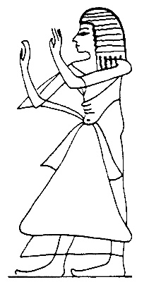
Mountain of the Gold
Bi’r Umm Fawakhir
Mountains of the Silver
Google
Scribe-of-the-Tomb Amennakhte
Scribe-of-the-Tomb Amennakhte, son of Ipuy, 1160 BCE
Map of sandstone quarry, gold mine and settlement at Bi’r Umm Fawakhir
Scribe-of-the-Tomb Amennakhte, son of Ipuy, 1160 BC

Slide 8
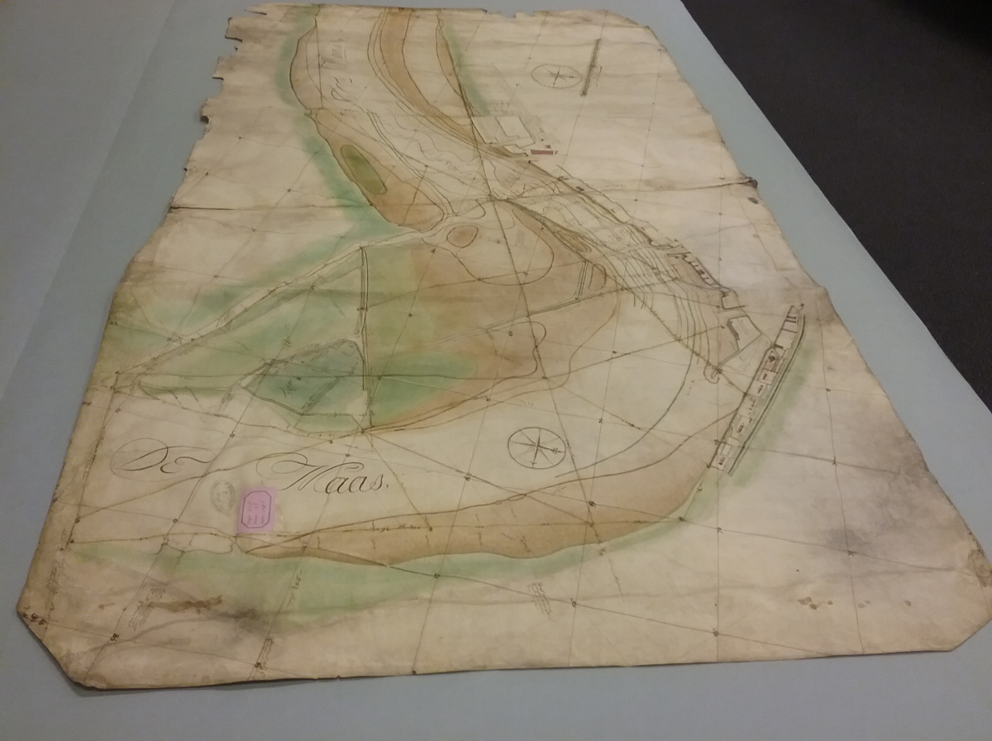
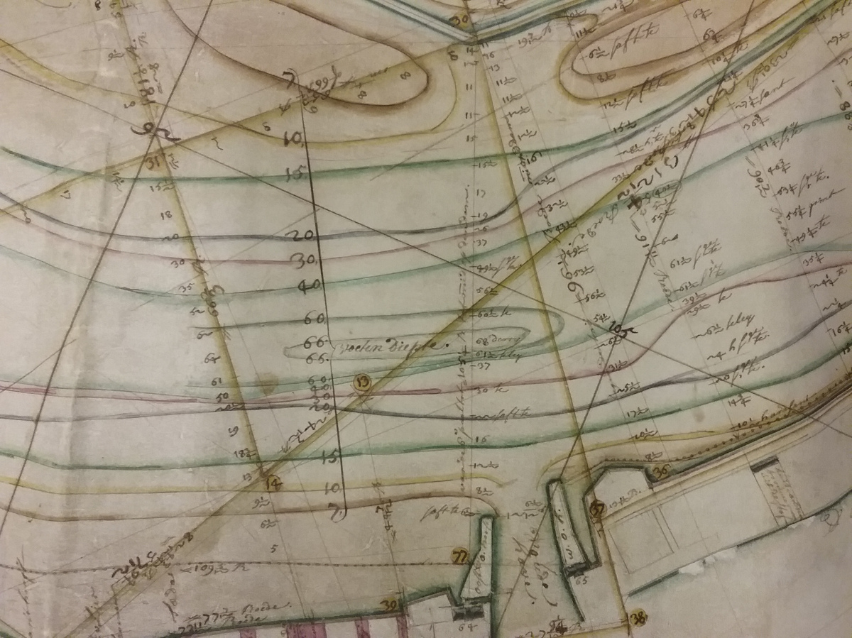
First contour map, River Maas, Netherlands
Pierre Ancelin,
1697
River Maas Isobaths
https://thegreatlinesproject.wordpress.com

Slide 9
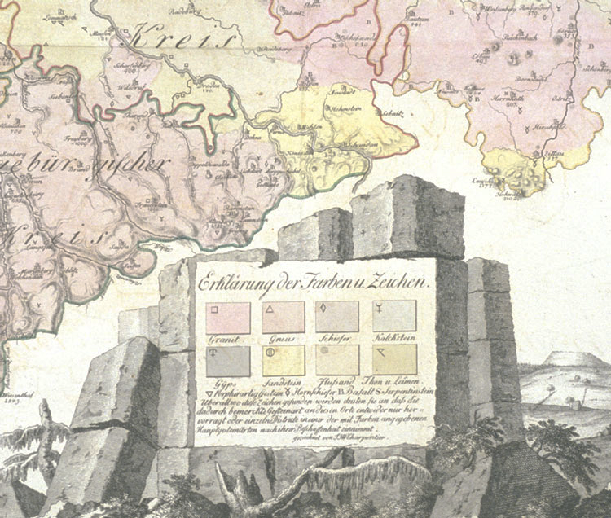
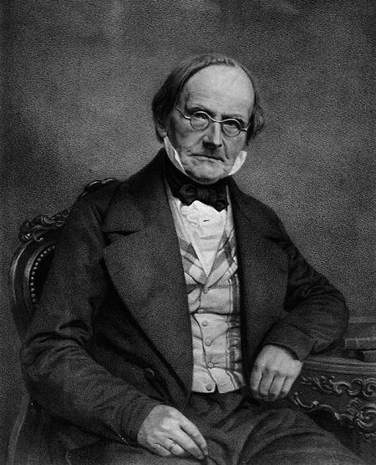
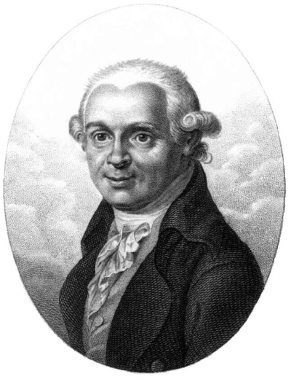
Johann von Charpentier,
1778
Johann Friedrich Wilhelm von Charpentier
Abraham Gottlob Werner
Johann Friedrich Wilhelm von Charpentier, 1778, Lithological map of Saxony (using colour scheme of Abraham Gottlob Werner)

Slide 10
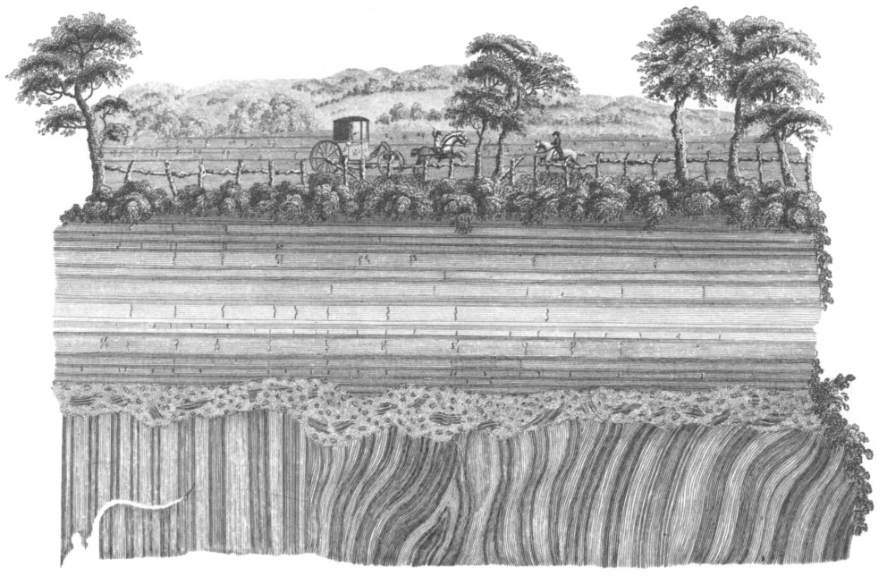
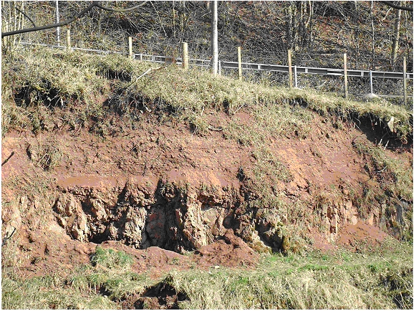
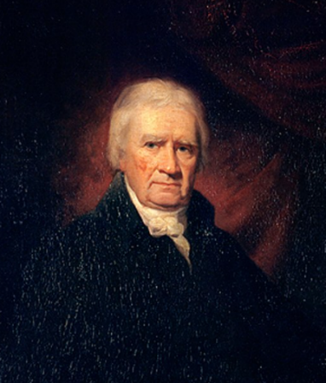
John Clerk of Eldin,
1787
Engraving by D.B. Pyet based on a drawing made in 1787 by John Clerk of Eldin of the Unconformity at Jedburgh, Borders, forming Plate III in Volume I of James Hutton's Theory of the Earth, 1795

Slide 11
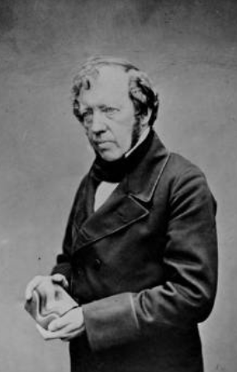
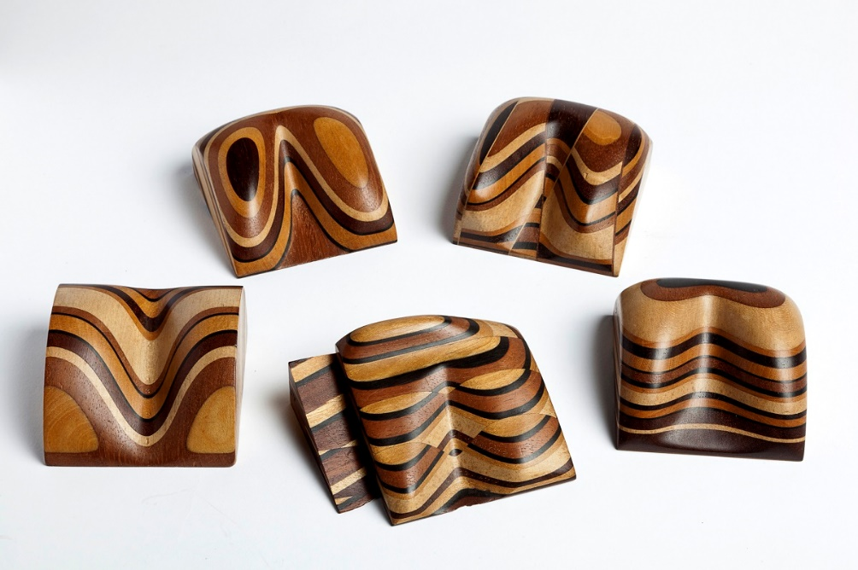
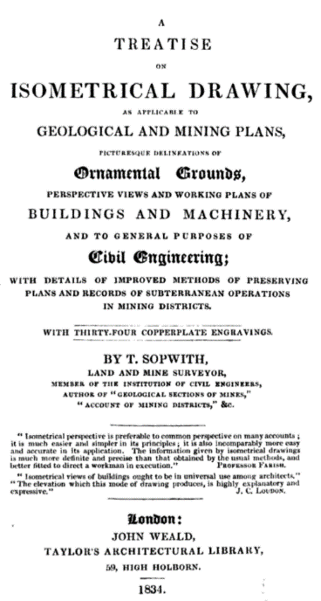
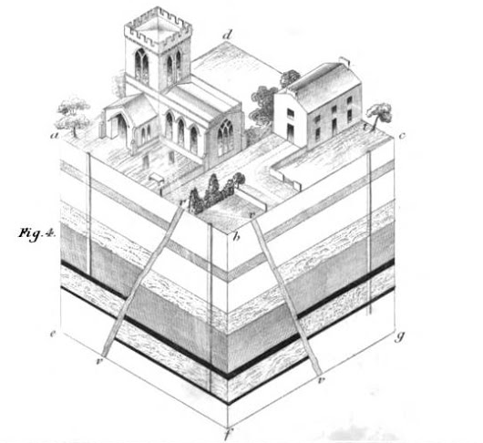
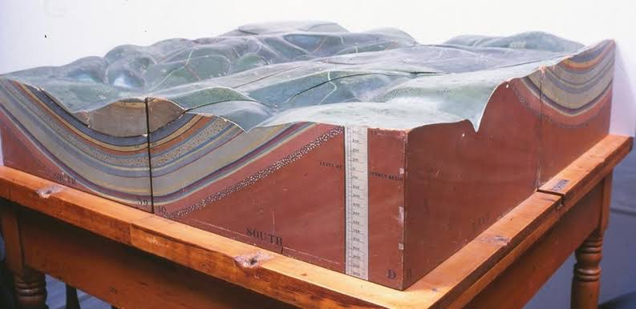
3D wooden models 1841
Thomas Sopwith 1834
Isometric drawings
Forest of Dean Model, 1837
Visualisation

Slide 12
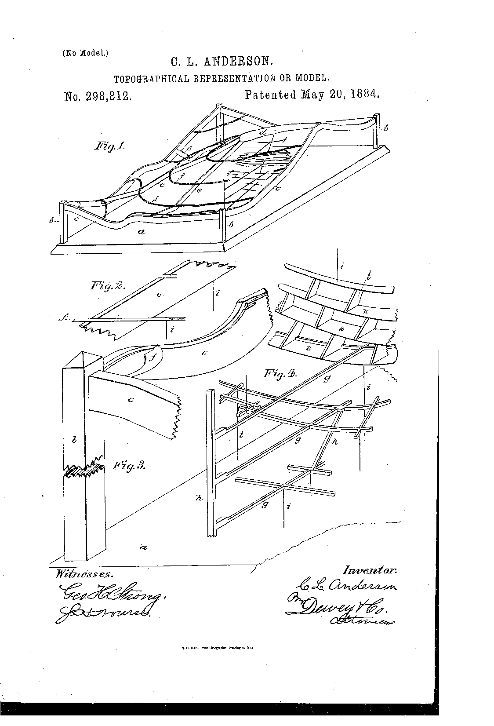
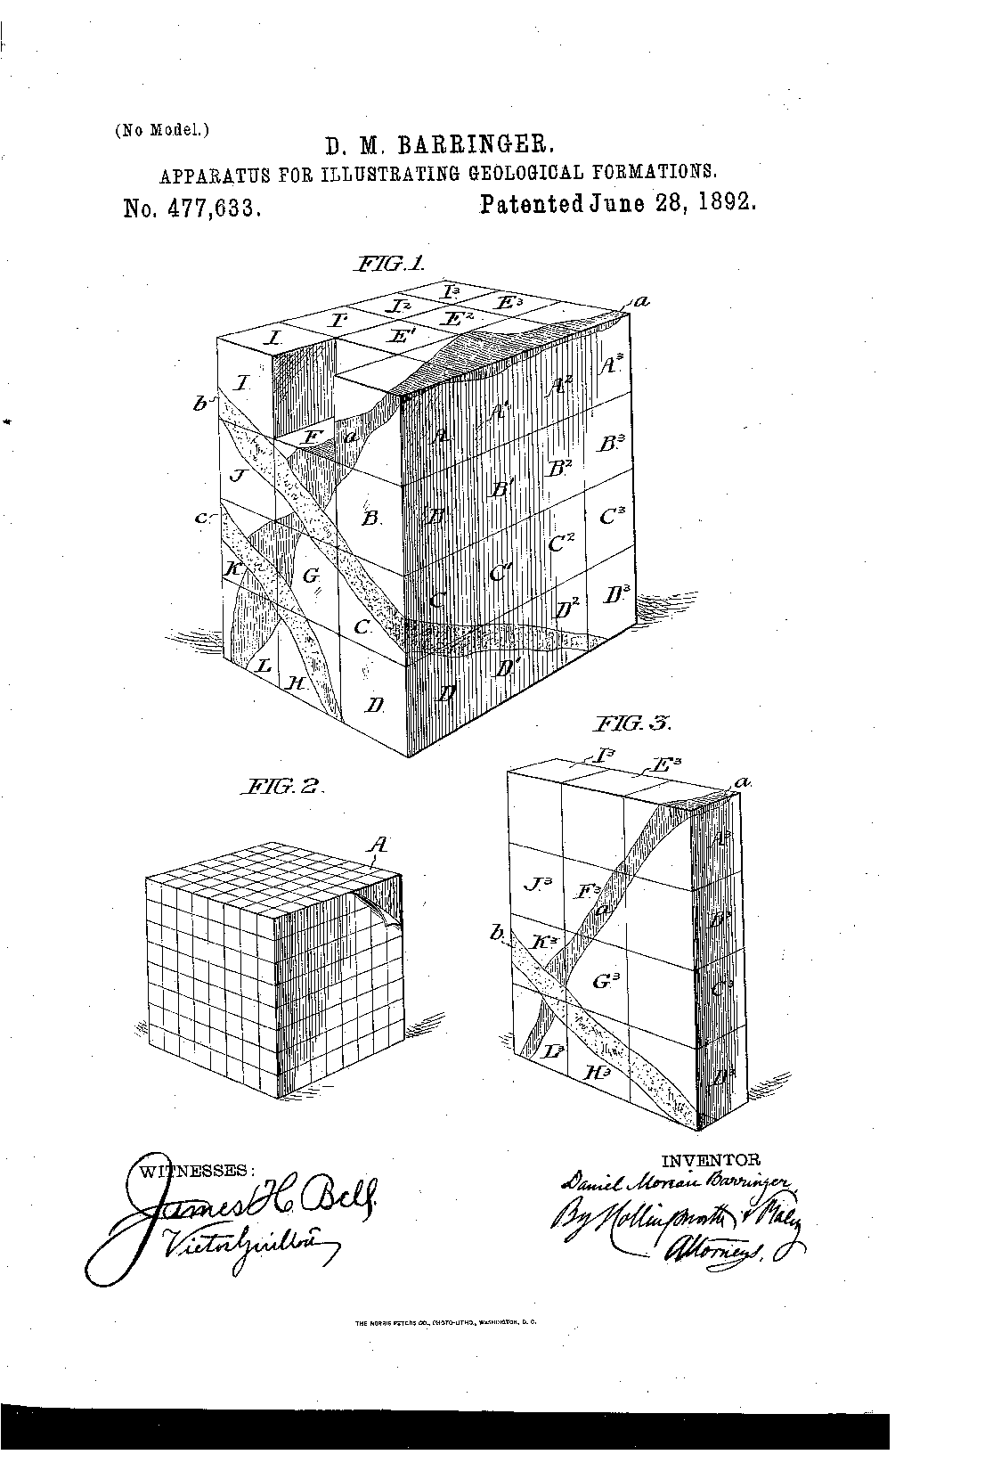
Clarence Anderson, 1884
Daniel Barringer,1892
The special adaptation of my invention is to a mine, of which I am thus enabled to represent clearly the shafts, drifts, or tunnels, stopes, and any other excavations, and also the surface of the country immediately surrounding it.
…primarily intended for facilitating mining operations by reproducing graphically and upon a uniform scale the geological structure of ore-beds and surrounding strata, so as to exhibit to the practical operator in a highly convenient manner sections upon any of the three coordinate planes and at any desired intervals.
L. Anderson. 1884. Topographical Representation or Model.
US Patent 298,812.
Daniel Moreau Barringer. 1892. Apparatus for Illustrating Geological Formations. US Patent 477,633

Slide 13
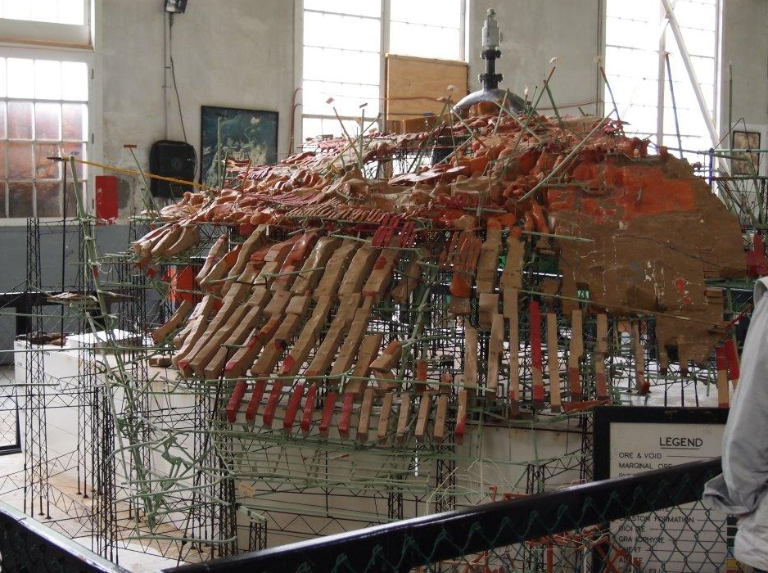
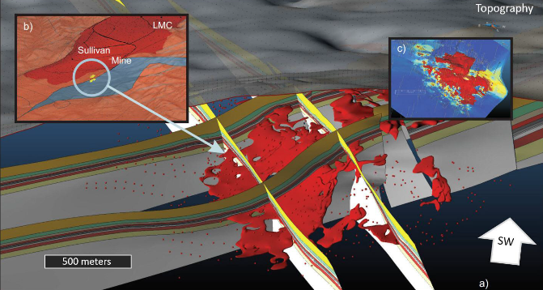
1940-1970s
3D Geological Model of the Sullivan Mine, 1940s
Photo Eric de Kemp
3D Geological Model of the Sullivan Mine, 2010s
de Kemp, E.A., Schetselaar, E.M., Hillier, M.J., Lydon. J.W., Ransom, P.W., Montsion, R., and Joseph, J., 2015. 3D Geological modelling of the Sullivan time horizon, Purcell Anticlinorium and Sullivan Mine, East Kootenay Region, southeastern British Columbia, Geological Survey of Canada, Open File 7838, p. 204-225.

Slide 14
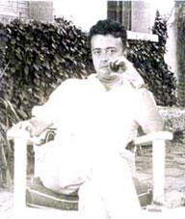
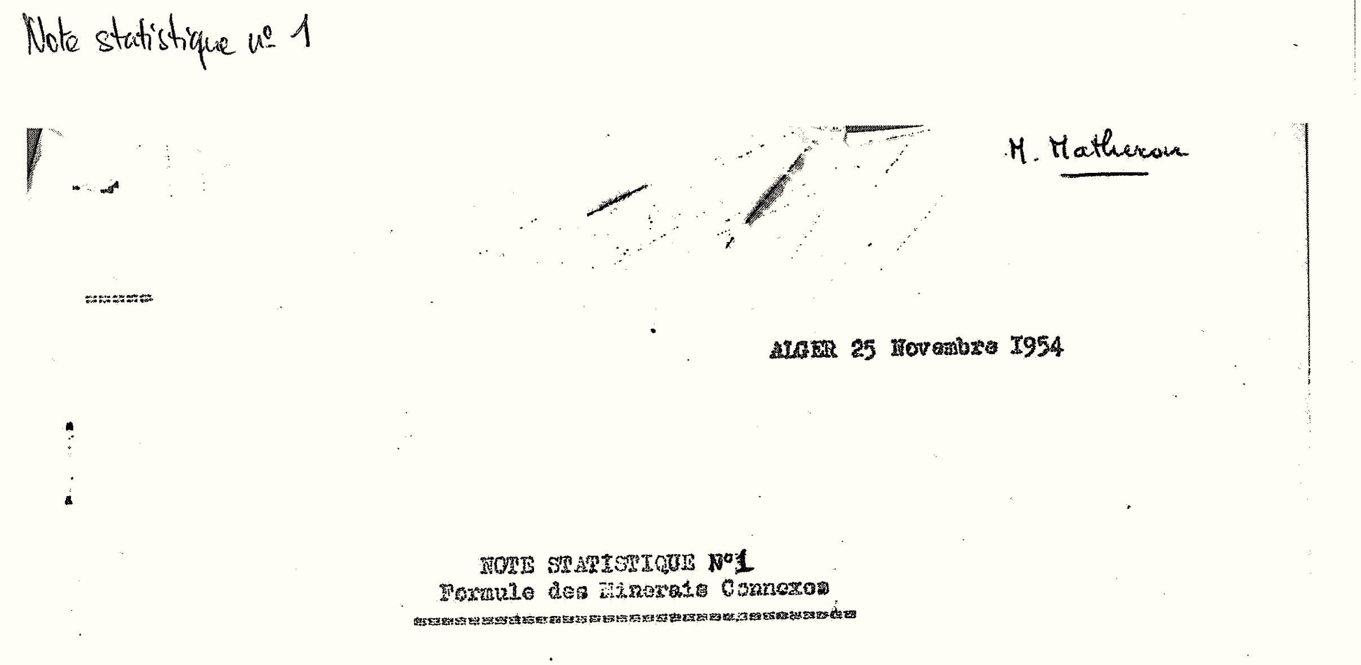
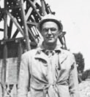
Danie Krige, 1951
Georges Matheron, 1954
Matheron, G. 1954. Formule des Minerais Connexes, Note Statistique No 1.
Krige, D.G, A statistical approach to some mine valuations and allied problems at the Witwatersrand, Master's thesis of the University of Witwatersrand, 1951

Slide 15
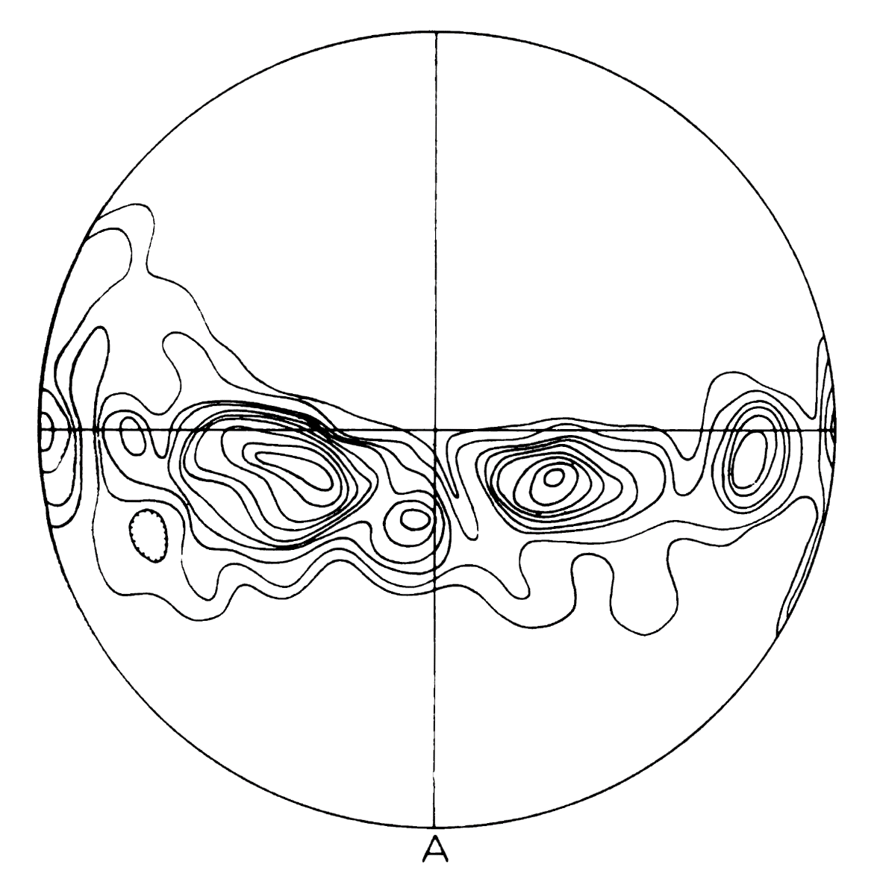
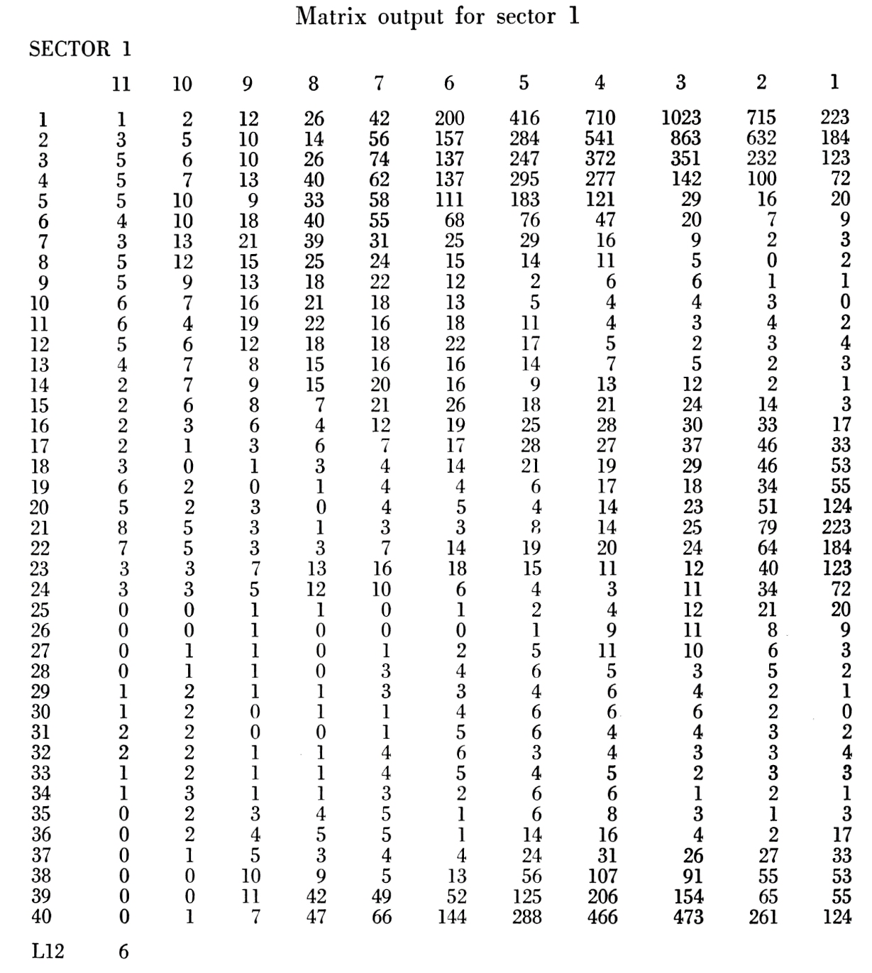
Robinson et al.,
1963
Hand drawn
Peter Robinson, Robin Robinson and Stephen J. Garland. 1963. Preparation of Beta Diagrams in Structural Geology by a Digital Computer, American Journal of Science, 261, 913-928.

Slide 16
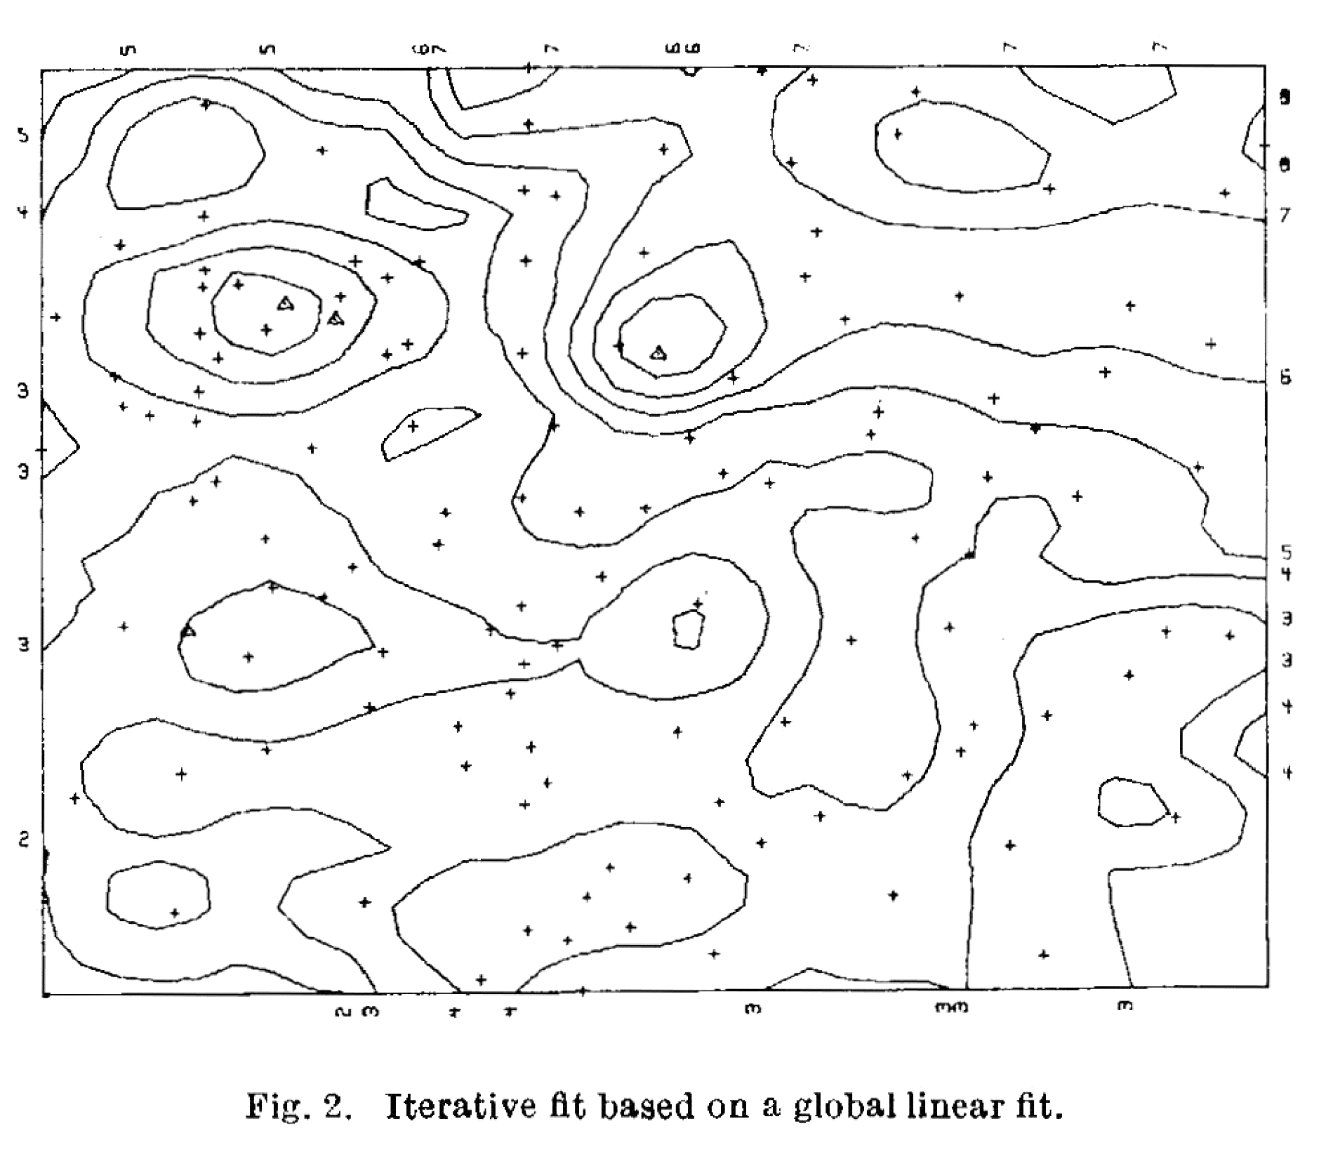
Cole,
1968
A.J. Cole, 1968, Algorithm for the Production of Contour Maps from Scattered Data, Nature, 220, 92-94.

Slide 17
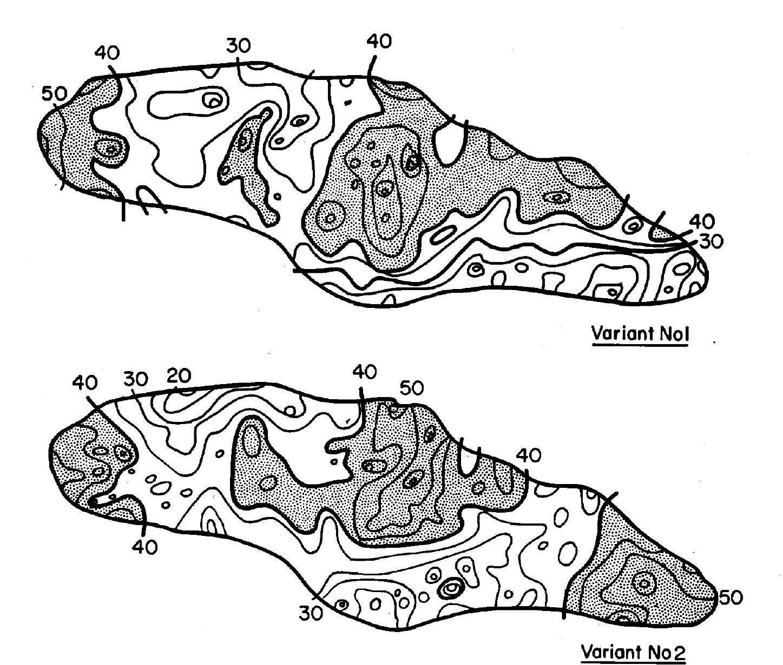
Journel,
1974
A. G. Journel. 1974. Geostatistics for Conditional Simulation of Ore Bodies Economic Geology and the Bulletin of the Society of Economic Geologists, 69, 673-687

Slide 18
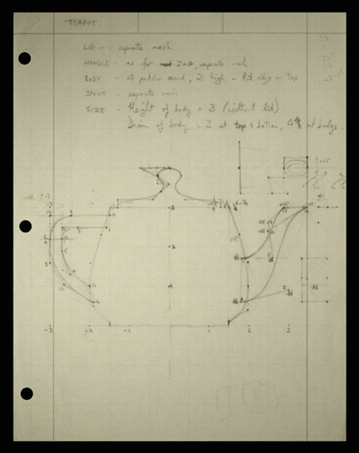
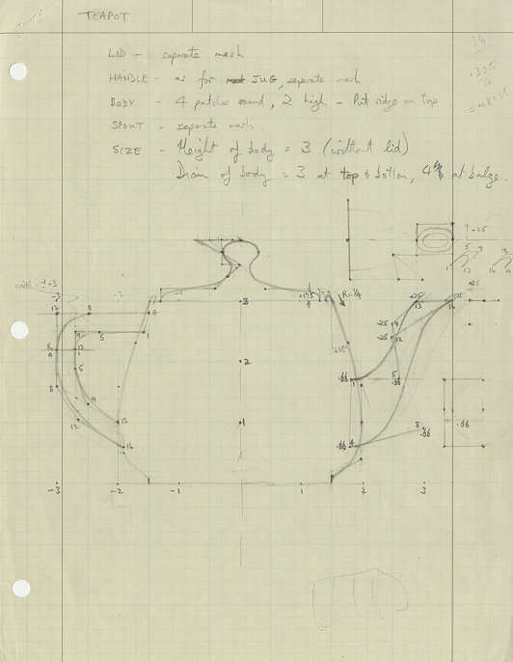
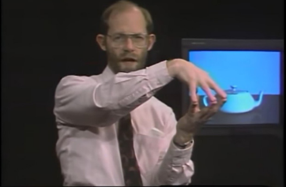
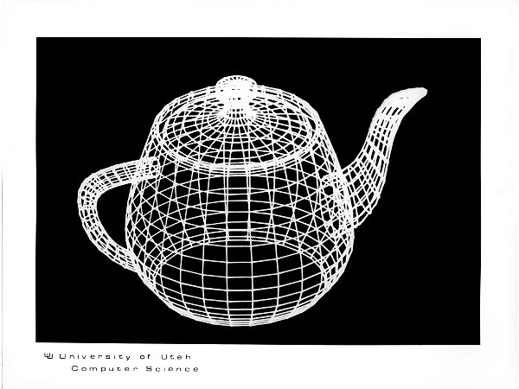
Martin Newall,
1975
M. Newall, 1975
hateplow@giphy

Slide 19
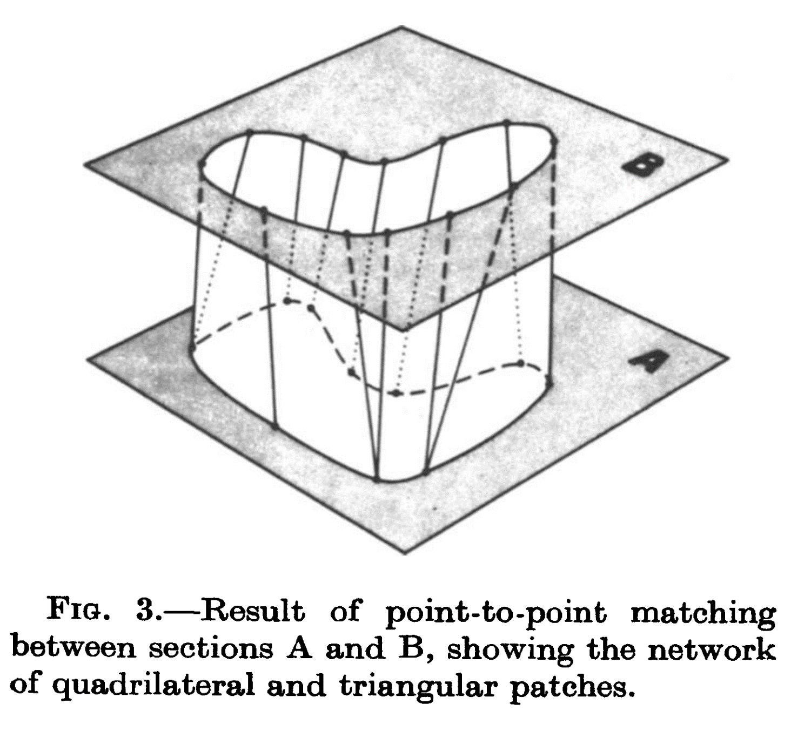
John Tipper,
1976
John C. Tipper. 1976. The Study of Geological Objects in Three Dimensions by the Computerized Reconstruction of Serial Sections. The Journal of Geology, Vol. 84, No. 4, 476-484

Slide 20
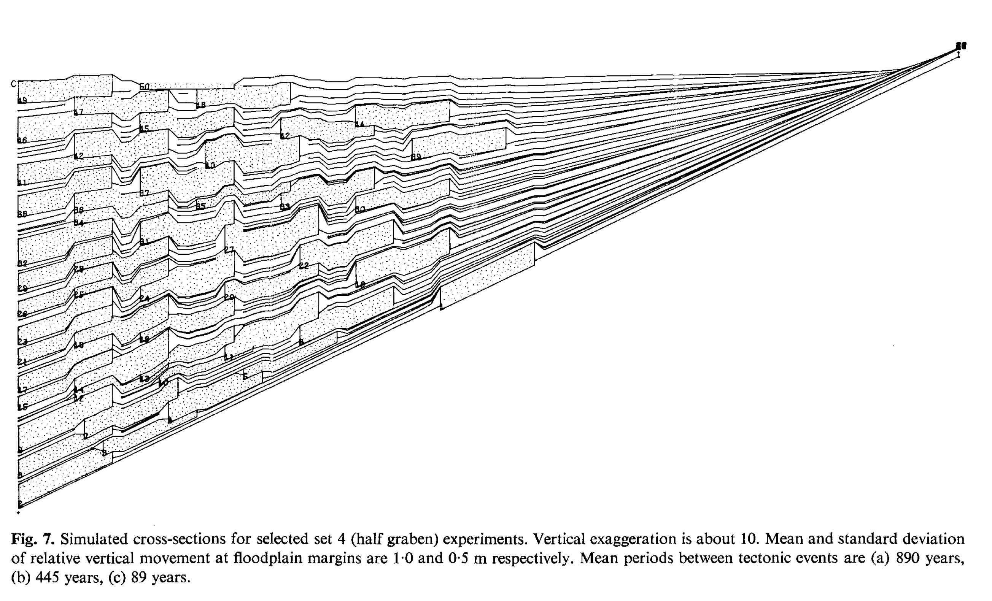
Bridge and Leeder,
1979
Simulated Cross-section
Bridge, J. S., and Leeder, M. R., 1979, A simulation model of alluvial stratigraphy: Sedimentology, v. 26, p. 617–644.

Slide 21

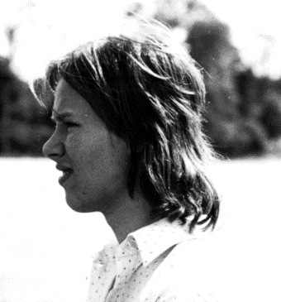
Jessell, 1981
Jessell, M.W. 1981. An interactive Map Creation Package, Unpublished MSc thesis, Unversity of London

Slide 22

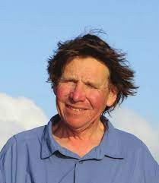
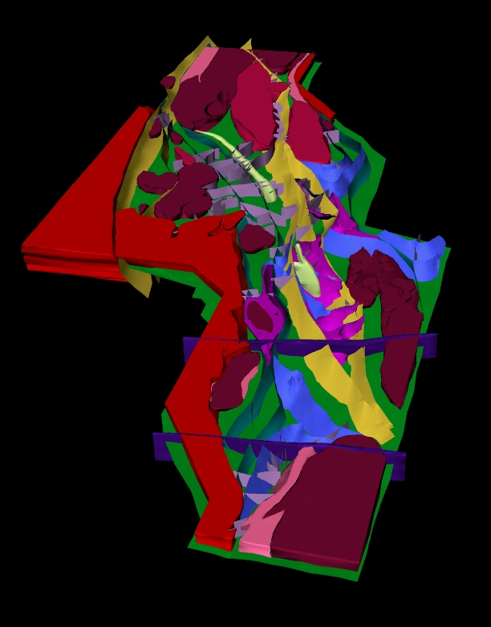
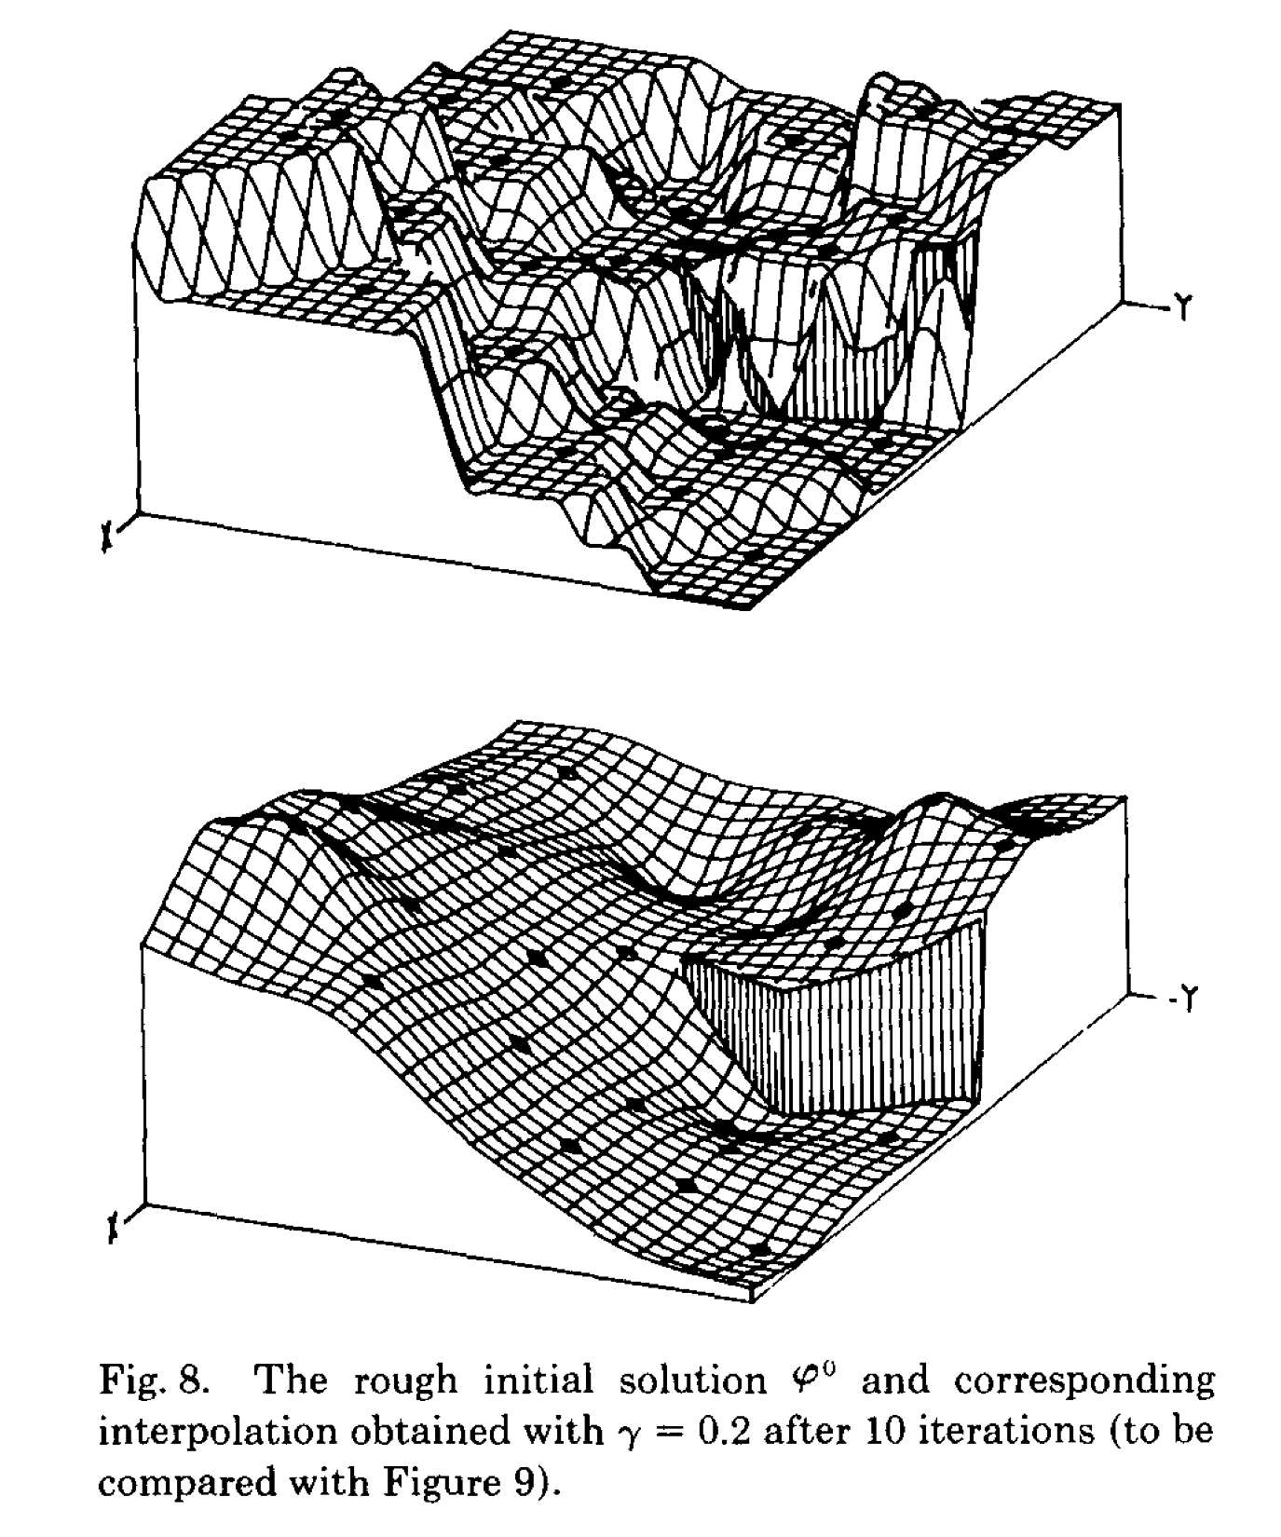
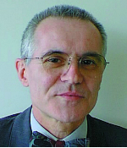
Jean-Laurent Mallet,1989
Fractal Graphics,1998
Jean-Laurent Mallet 1989 , Discrete smooth interpolation. ACM Transactions on Graphics, 8, 121-144
Fractal Graphics (Norseman-Menzies)

Slide 23

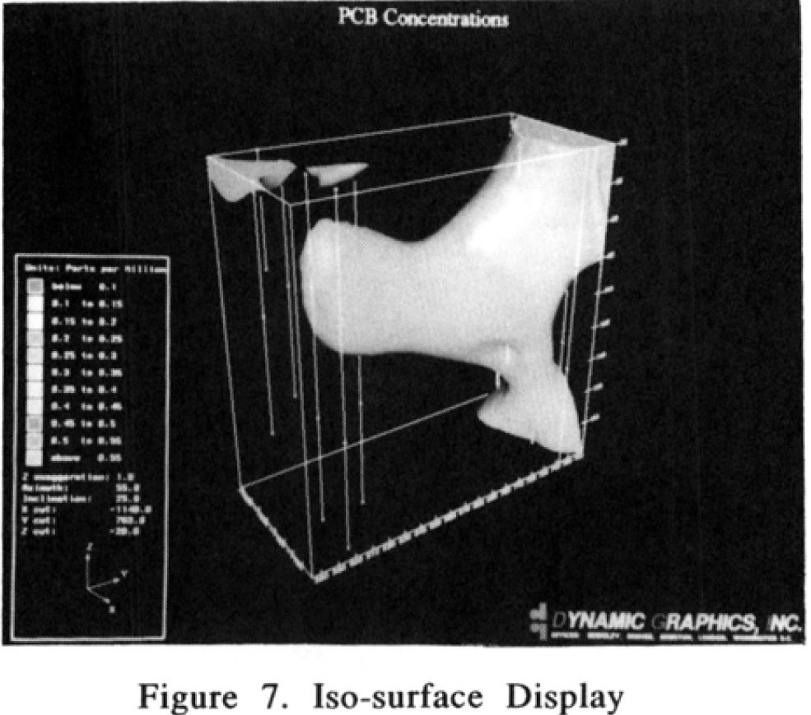
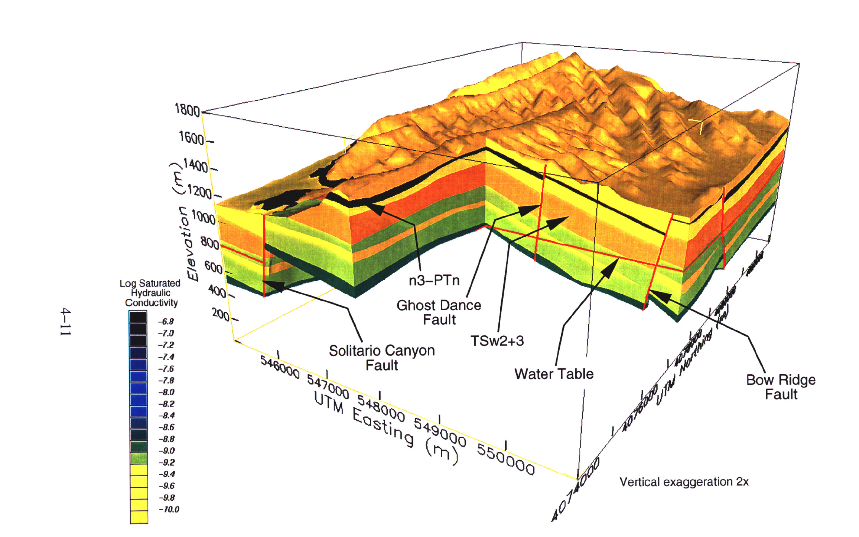
Smith & Paradis
1989
Stirewalt and Henderson,
1995
Smith, D.R. & Paradis, A.R. Three-Dimensional GIS of the Earth Sciences, Proceedings of the International Symposium on Computer-Assisted Cartography, April 2 - 7, 1989
G. Stirewalt and B. Henderson, 1995, A Three-dimensional Geological Framework Model for Yucca Mountain, Nevada, with Hydrologic Application: Report to Accompany 1995 Model Transfer to the Nuclear Regulatory Commission

Slide 24
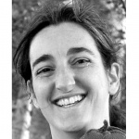
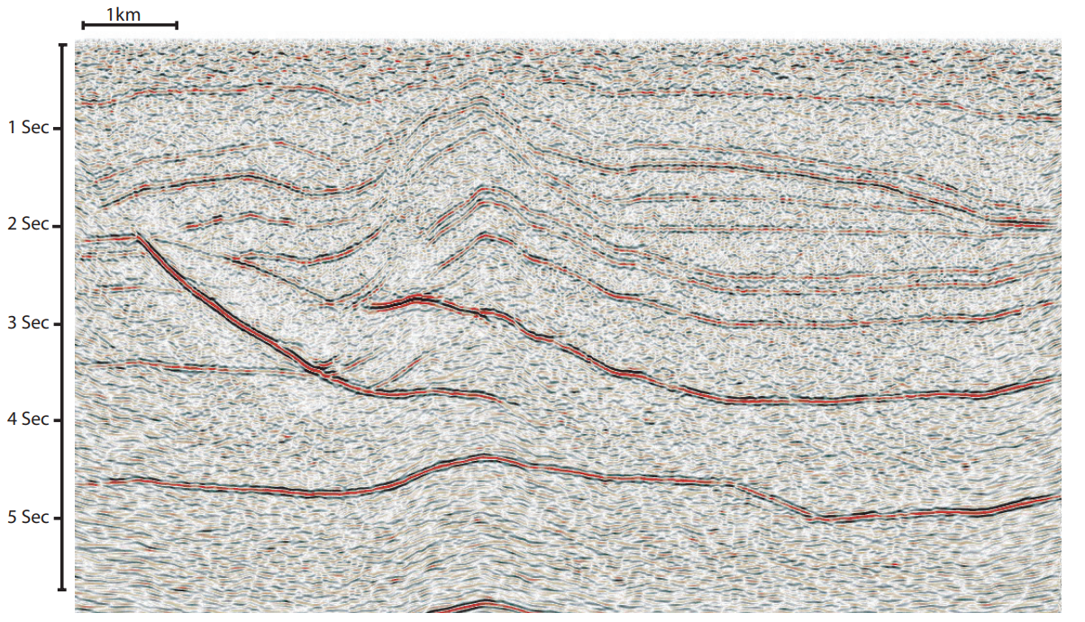
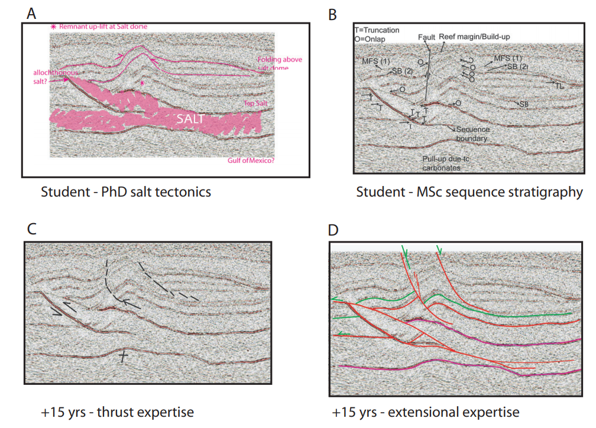
Bond et al. 2007
Synthetic seismic data
What do you think this is? “Conceptual uncertainty” in geoscience interpretation C.E. Bond, A.D. Gibbs, Z.K. Shipton, and S. Jones. GSA Today: v. 17, no. 11 2007

Slide 25
Human Intervention
Time to build first model
Uncertainty Quantification
Trends
Geophysics Integration
Redraw Model
Add fictive data points
Automated geological analysis
Hidden use of geological knowledge
Overt use of geological knowledge
1 Model = Complete uncertainty
Many Models = Uncertainty Quantified
Geophysics as source or test of model
Integrated inversion

